Slide 1







Stack Overflow Developer Survey
Akhila Reddyrajula
02/27/24

Slide 2



OUTLINE
Executive Summary
Introduction
Methodology
Results
Visualization – Charts
Dashboard
Discussion
Findings & Implications
Conclusion
Appendix

Slide 3

EXECUTIVE SUMMARY
The presentation provides a comprehensive analysis of data gathered from the annual surveys conducted by Stack Overflow, a leading online platform for sharing programming knowledge, focusing on technology usage and trends among developers.
Utilizing a subset of datasets from the 2019 surveys, which amassed responses from a total of 85,987 participants, including the Data Technologies Survey for Developers (with 74,589 respondents) and a demographic survey of developers (with 11,398 participants), the analysis delves into the current state of software technology users.
Key insights derived from the analysis shed light on various aspects, including the prevailing preferences and adoption rates of software technologies, developers' aspirations for the upcoming year, and the demographic profile of the developer community.
The findings presented in the analysis are particularly relevant and beneficial to a diverse audience comprising developers, HR professionals, educators, policymakers, IT industry leaders, as well as students at different stages of their career trajectories.
By offering a nuanced understanding of the software technology landscape and its implications, the presentation aims to empower stakeholders with actionable insights to make informed decisions, drive strategic initiatives, and shape future directions in the field of technology and software development.

Slide 4

INTRODUCTION
This presentation report leverages data analytics to unveil current and projected trends in the demand for programming languages, databases, platforms, and web frameworks, alongside insights into respondent demographics.
Through an examination of Stack Overflow's annual Developer Survey, the largest and most comprehensive survey of coders globally, with nearly 90,000 developers contributing, this analysis sheds light on technology trends and the characterization of developers worldwide.
Key areas of investigation include programming languages, databases, program platforms, and web frameworks, as well as demographic classifications by gender, country, age, and education.
While recognizing that survey results may not uniformly represent all segments of the developer community, this analysis aims to predict trends and offer valuable insights for IT professionals, HR managers, and anyone interested in the evolving IT sector.
By providing a deeper understanding of current and future trends in IT skills demand, this presentation equips stakeholders with actionable insights to navigate and thrive in the dynamic landscape of the technology industry.

Slide 5

OBJECTIVES The main objectives of this presentation
Gain insight into global software technology usage trends.
Utilize analytical tools to predict future technology trends in software development worldwide.
Understand the demographic structure of software technology users globally.
Use acquired knowledge to inform decision-making related to the adoption and utilization of software technologies.

Slide 6
OBJECTIVES
Current Technology Usage
Displays Top 10 Languages Worked With according to the survey
Displays Top 10 Database Worked With according to the survey
Displays Platform Worked With according to survey
Displays Top 10 Web Frame Worked With according to survey
Future Technology Trend
Displays Top 10 Language Desires Next Year according to the survey
Displays Top 10 Database Desire Next Year according to the survey
Displays Platform Desire Next Year according to survey
Displays Top 10 Web Frame Desire Next Year according to the survey
Demographic
Displays the Respondent classified by Gender according to the survey
Displays Respondent Count for Countries by survey
Displays Platform Desire Next Year according to survey
Displays the Top 10 Web Frame Desire Next Year according to the survey

Slide 7

METHODOLOGY
Collect survey data & explore its content
Web Scraping
APIs.
Request library.
Data Wrangling
Exploratory data analysis
Analyzing data distribution
Handling outliers.
Correlations.
Data Visualization
Highlight distribution of data, relationships, the composition and comparison of data.
Dashboards

Slide 8
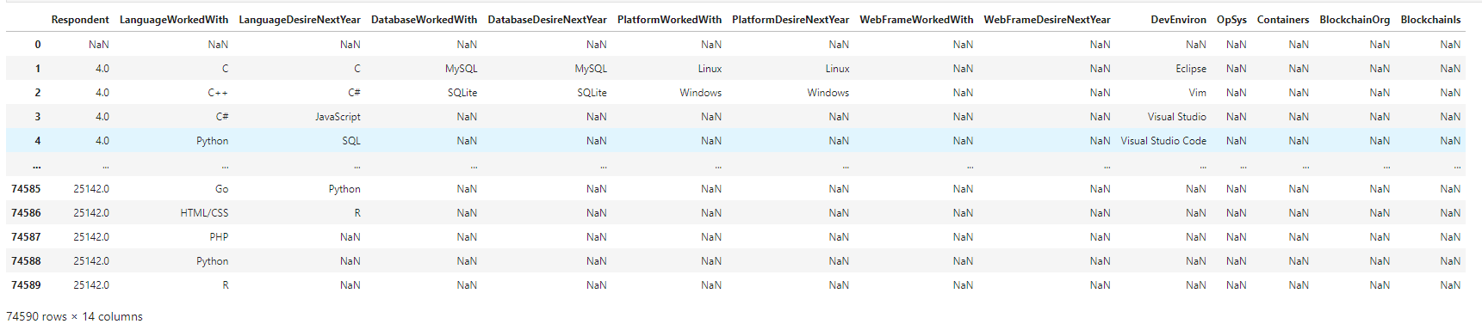
RESULTS Technology trends
Overall data : in total 13 questions & 74,590 responders

Slide 9
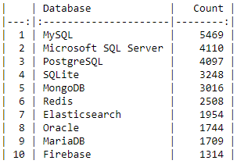
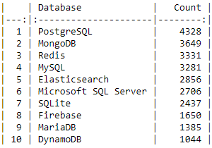
RESULTS Technology trends Programming Languages
DATABASE TREND – PRESENTED DATA COMPARATIVELY D – PRESENTED DATA COMPARATIVELY
Database that are used the most
Database most desired for next year

Slide 10
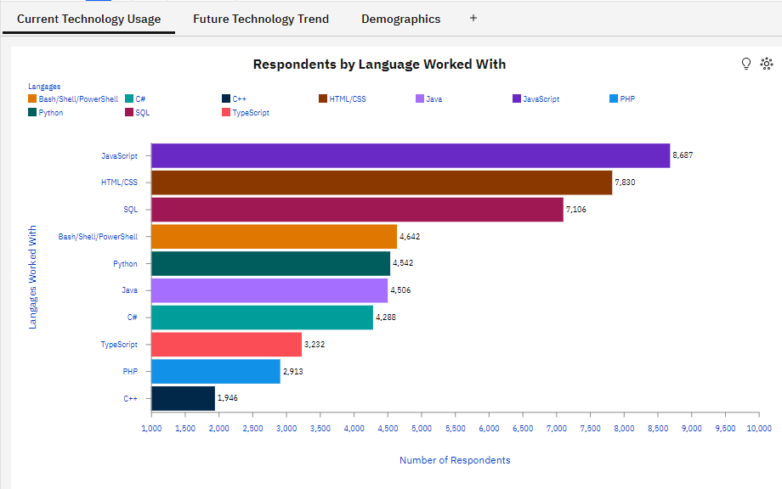
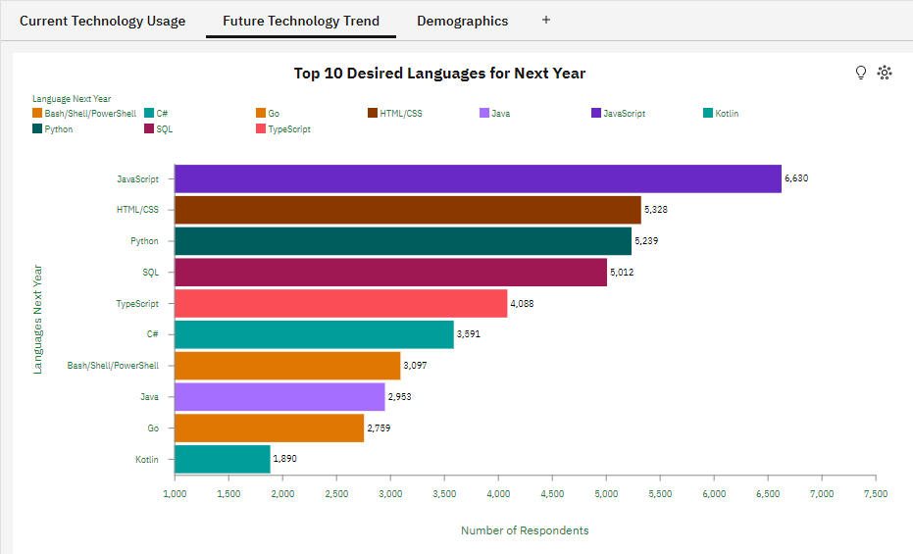
TRENDS PROGRAMMING LANGUAGE
Current Year
Next Year

Slide 11
PROGRAMMING LANGUAGE TRENDS - FINDINGS & IMPLICATIONS
Findings
JavaScript and HTML/CSS dominate the programming language landscape, suggesting a strong focus on web applications among respondents, a trend expected to persist in the upcoming year.
SQL maintains its position as the top choice for managing large databases and is anticipated to remain so for the foreseeable future.
The growing popularity of Python indicates a rising preference for this high-level, interpreted language, widely used for various general-purpose programming tasks.
'C Sharp' (C#), recognized as a modern object-oriented programming language, continues to attract significant interest among respondents, with an anticipated increase in interest in the coming year.
Implications
The analysis results clearly indicate a predominant orientation of respondents towards web design.
Python's popularity surge is attributed to the rapid advancements in AI technology and its extensive library support, garnering increased interest among respondents.
Database management maintains a high level of interest among respondents, positioning it as the third-largest interest group within software technology.

Slide 12
DATABASE TRENDS
Current Year
Next Year

Slide 13
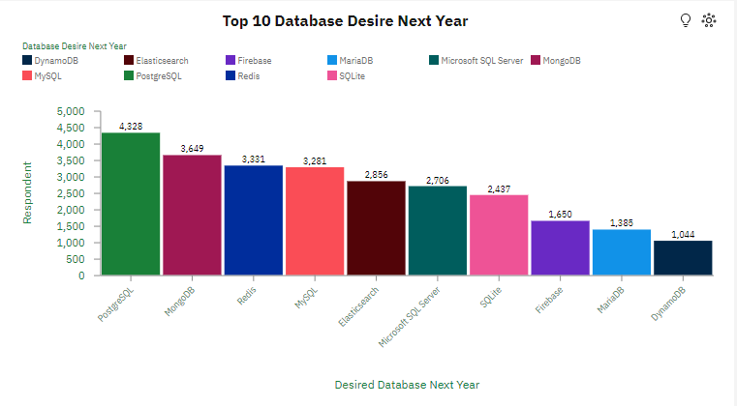
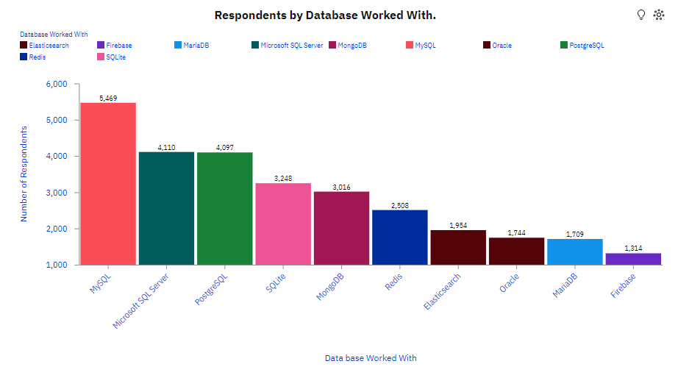
TRENDS DATABASE
Current Year
Next Year

Slide 14
DATABASE TRENDS - FINDINGS & IMPLICATIONS
Findings
MySQL currently holds the top spot as the most utilized database management language, surpassing others by a considerable margin. However, there is a notable decline in interest in its usage for the upcoming year.
Microsoft SQL Server and PostgreSQL are equally popular among developers, trailing behind MySQL in usage. While interest in Microsoft SQL Server is on a significant decline, PostgreSQL is emerging as the preferred database language for the next year.
Firebase stands out among the top ten most used databases, with increasing interest in its utilization anticipated for the coming year.
MongoDB and Redis are the leading NoSQL databases in terms of usage among respondents.
Implications
PostgreSQL is anticipated to be the top choice for the upcoming year due to its reputation for robustness, reliability, and scalability as a relational database management system.
The rising interest and usability of MongoDB, a document-oriented database program utilizing JSON-like documents with optional schemas, position it as the second most preferred database among respondents for the coming year.

Slide 15
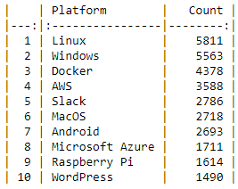
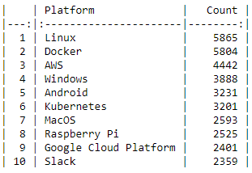
TRENDS PLATFORMS
Current Year
Next Year

Slide 16
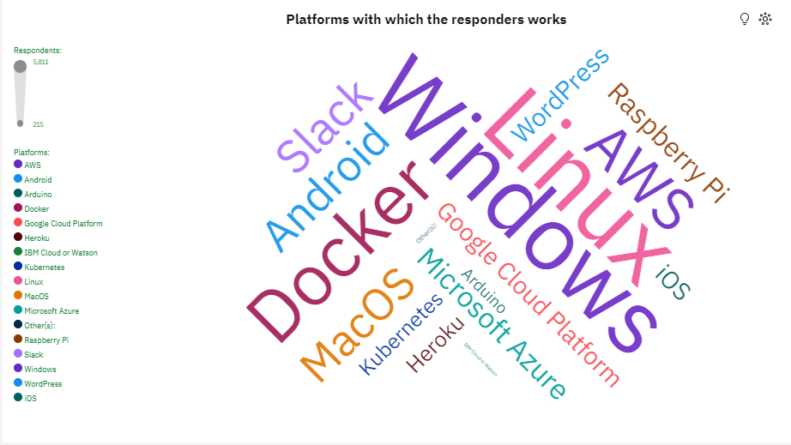
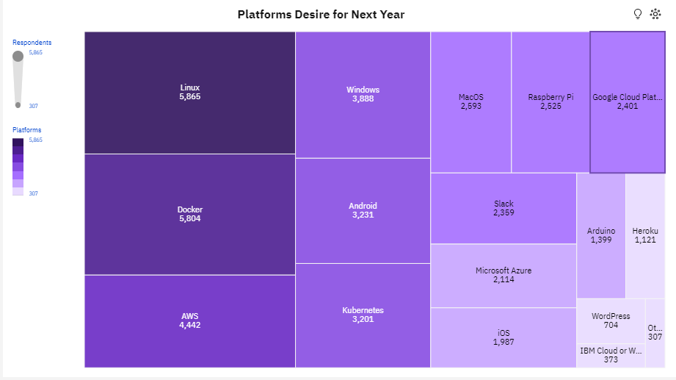
TRENDS PLATFORMS
Current Year
Next Year

Slide 17
TRENDS PLATFORM - FINDINGS & IMPLICATIONS
Findings
Linux and Windows dominate as the most used operating system platforms, with Linux leading the pack.
Interest in Windows for the next year is waning, while there's a notable rise in interest for containerization platforms like Docker and cloud computing platforms such as Amazon Web Services (AWS).
Slack is widely utilized as a collaboration platform, although interest is declining for the upcoming year, coinciding with a sharp increase in interest for Google Cloud Platform (GCP) and Kubernetes.
While interest in MacOS shows a slight decrease for the coming year, there's a growing interest in Android as a mobile application platform among respondents.
Implications
While interest in using operating system platforms for the next year shows a significant decrease, the majority of respondents will still be working on these platforms.
Containerization platforms are expected to maintain their position as the second most used platform among respondents in the coming year, with a notable surge in interest. This is particularly evident as Docker ranks second in terms of interest, and Kubernetes is among the top 10 most preferred platforms.

Slide 18
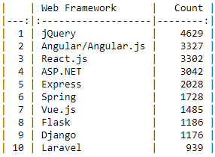
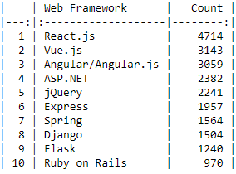
TRENDS WEB FRAMEWORK
Current Year
Next Year

Slide 19
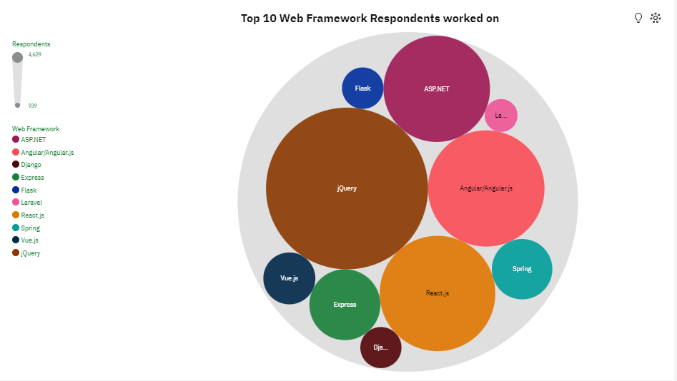
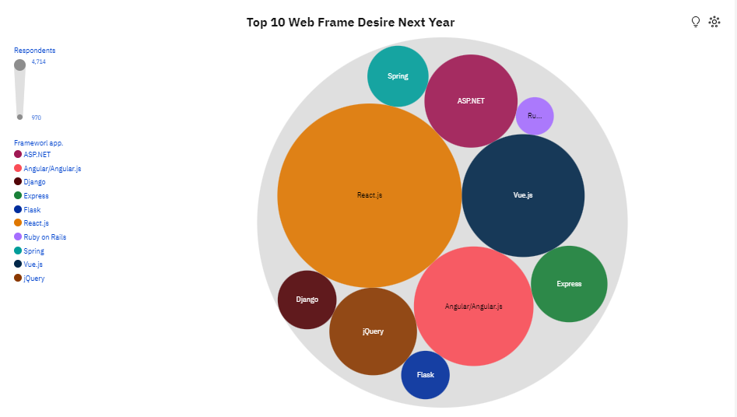
TRENDS WEB FRAMEWORK
Current Year
Next Year

Slide 20
TRENDS WEB FRAMEWORK - FINDINGS & IMPLICATIONS
Findings
Among respondents, popular JavaScript libraries and frameworks are leading in user numbers.
Interest in jQuery for the next year is cut in half, while React.js emerges as the most appealing option.
Vue.js experiences an almost threefold increase in interest for the coming year, securing its position as the second most preferred web platform.
Interest in ASP.NET, a Microsoft .NET platform, remains unchanged for the following year, maintaining its fourth position with a slight decrease in interested respondents.
Flask and Django, Python web frameworks, undergo slight positional changes in the following year, accompanied by a noticeable percentage increase in interested respondents.
Implications
Open source JavaScript libraries and frameworks, notably React.js and Angular, dominate in terms of usage and preference.
Including Express and Vue.js as open source web application frameworks for Node.js reaffirms JavaScript as the most preferred programming language.
The survey highlights not only the usage but also the increasing interest and intention to further utilize web frameworks for Python, particularly through Django and Flask.

Slide 21
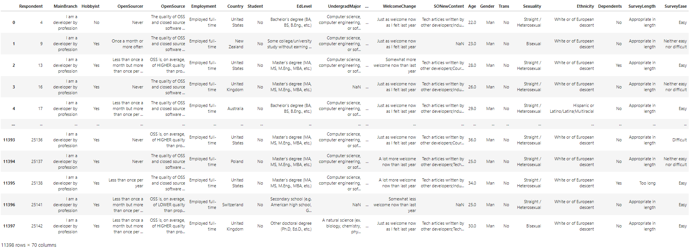
DEMOGRAPHIC

Slide 22
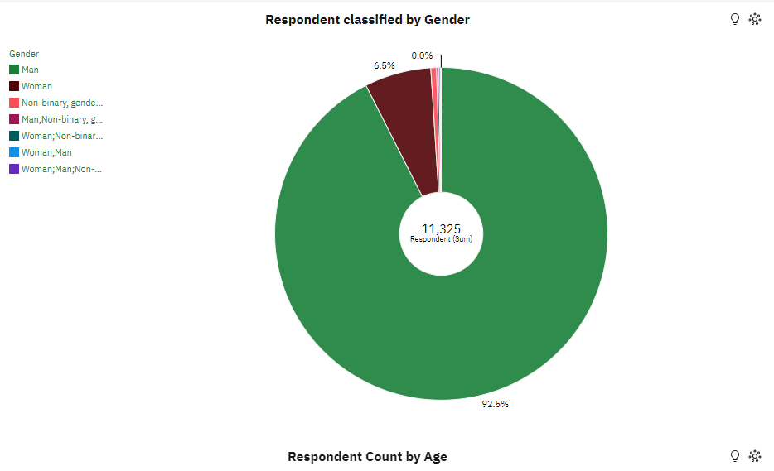
DEMOGRAPHIC
Classified by Gender
Gender classified by Formal Education

Slide 23
DEMOGRAPHIC
Findings
The vast majority of respondents, totaling 92.5%, identified as male, while only a small fraction, comprising 6.5%, identified as female.
A negligible percentage, less than 1%, declared themselves with other gender classifications.
Over half of male respondents hold a Bachelor's degree, with a similar proportion observed among female respondents.
Implications
The gender ratio among respondents is concerning, with a notably low participation from those identifying as female.
The prevalence of higher levels of formal education is attributed to the challenges inherent in working with software technologies.

Slide 24
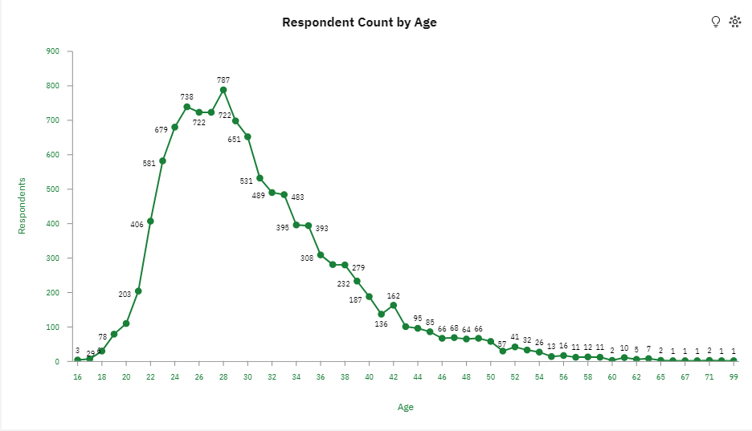
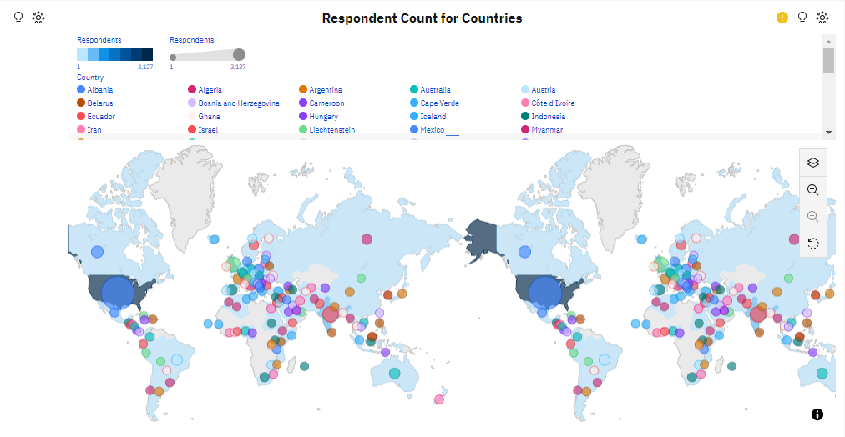
DEMOGRAPHIC
Classified by Age
Gender classified by Country

Slide 25
DEMOGRAPHIC
Findings
Among the respondents, the age group between 24 and 30 years old is the most prevalent, with 28-year-olds being the most represented.
The survey encompassed participants from 135 different countries, with the majority originating from the United States. The number of respondents from the US is nearly four times higher than that of the second-ranked country, India. Following closely are countries such as the United Kingdom, Germany, Canada, and others.
Implications
There is a notably low response to the survey from individuals under the age of 20 and over the age of 40, which is disappointing considering the significant intellectual potential within these age brackets.
The sole respondent aged 99 and the three respondents aged 16 should be viewed as positive examples and sources of encouragement.
While it's encouraging to see a large number of countries represented among the respondents, the response from many countries is minimal. Particularly disappointing is the low response from China, with only 69 registered respondents despite its large population and technological advancements in informatics.

Slide 26
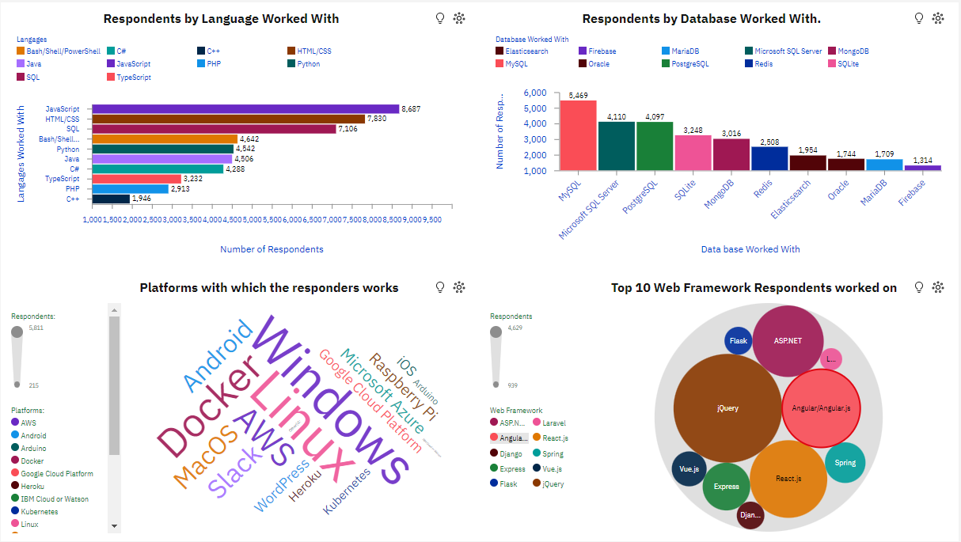
DASHBOARD Current Technology Use Dashboard Tab 1
– PRESENTED DATA COMPARATIVELY
Database that are used the most

Slide 27
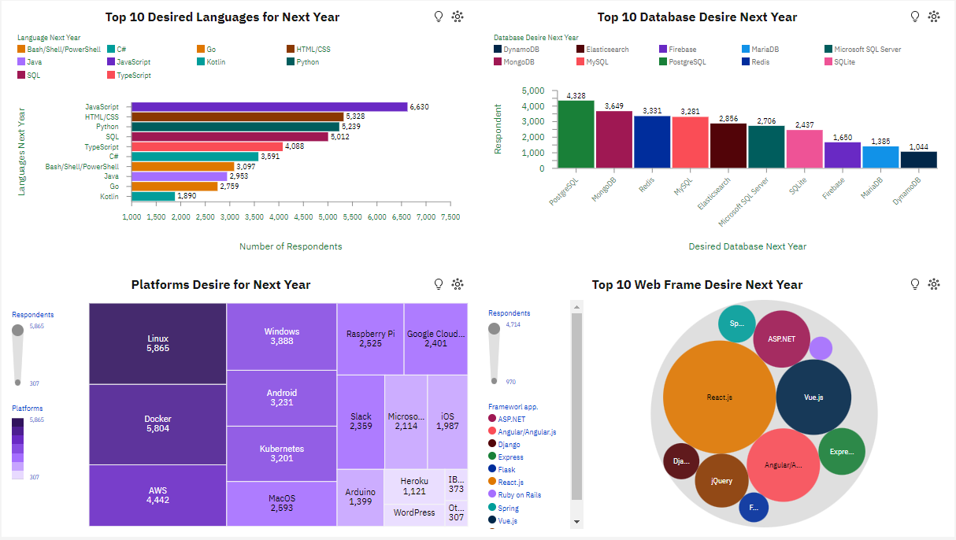
DASHBOARD Future Technology Trend Dashboard Tab 2
– PRESENTED DATA COMPARATIVELY
Database that are used the most

Slide 28
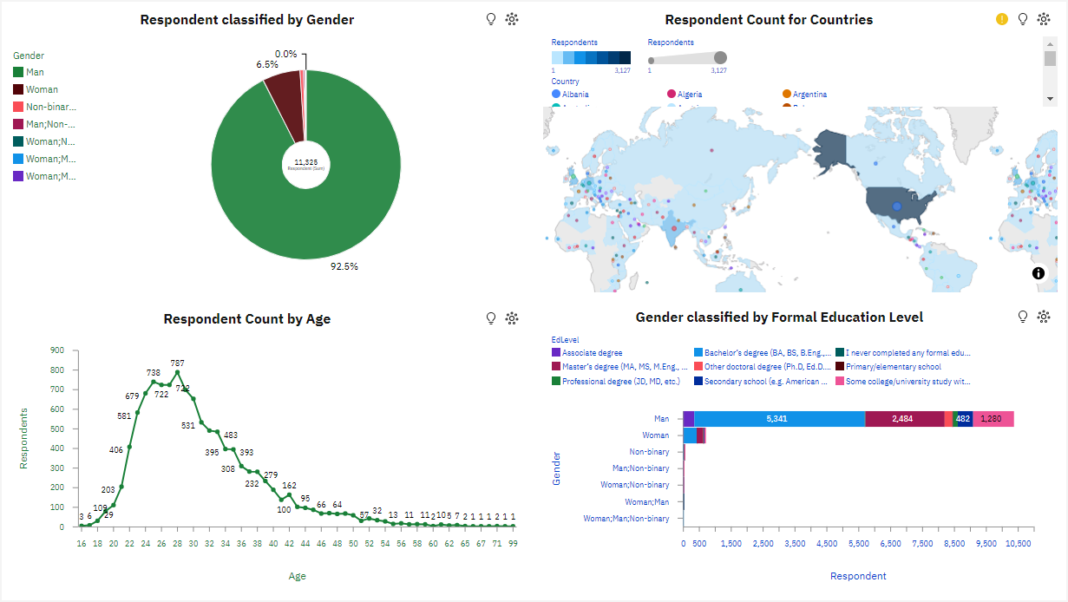
DASHBOAR Demographic Dashboard Tab 3
– PRESENTED DATA COMPARATIVELY
Database that are used the most

Slide 29
DEMOGRAPHIC
Findings
JavaScript and HTML/CSS continue to maintain their leading interest among users of software technologies, both presently and in the future.
There's a noticeable surge in interest for Python anticipated in the future.
Regarding databases, PostgreSQL, MongoDB, and Redis are projected to be much more attractive options for the future compared to MySQL and Microsoft SQL Server.
In the realm of web frameworks, there's clear evidence of JQuery fatigue, alongside a growing interest in React.js and particularly Vue.js.
The demographic structure of respondents in terms of gender is remarkable, with a striking 92.5% identifying as men, while only 6.5% are women within the field of software technologies.
Implications
The majority of respondents show a strong inclination towards web software technologies, and this interest is expected to persist in the future.
The analysis highlights a rising interest in interpreted programming languages.
There is a notable increase in interest towards open source software for databases.
The small percentage of respondents identifying as women distorts the true representation across all segments of the population involved in software technologies.

Slide 30
CONCLUSION
Developers specializing in functional programming languages like Clojure and F# typically receive higher salaries within the software technology field.
Conversely, those working within web environments or utilizing general-purpose interpreted languages such as Python tend to receive lower salaries, despite being highly sought after.
The attractiveness and desirability of these languages stem from their open-source nature, providing significant advantages in development.
The presence of expansive developer communities contributing to various open-source libraries, frameworks, and providing support fosters creativity and dynamism.
Python's increasing popularity and versatility contribute to its rising demand and remuneration as a programming language.
Overall technological advancements and the demand for innovation continuously drive changes and progress within software technologies.
To foster further growth and inclusivity, efforts are needed to eliminate discrimination based on age, gender, and race, while also expanding the programming community to encompass more countries worldwide.

Slide 31
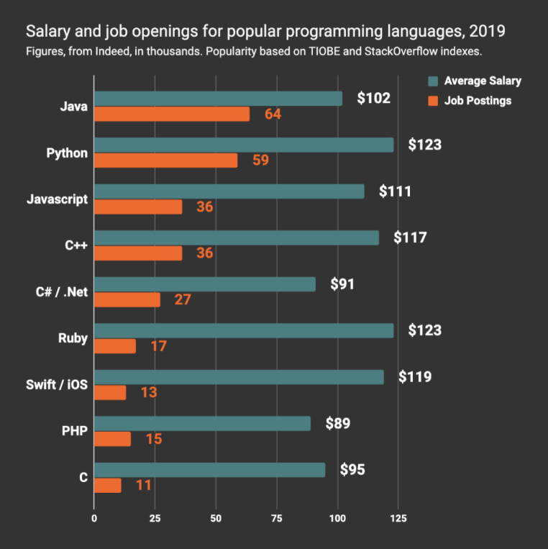
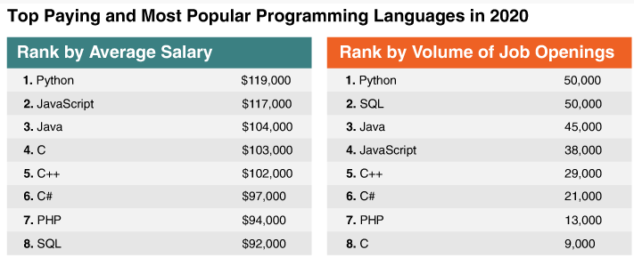
APPENDIX Job Openings Popular Programming Languages
Python retains its position as the most attractive option in both salary and demand for programmers among popular programming languages in the upcoming year.
While there is an equal demand for SQL developers, their salaries are not as incentivized as those of Python developers for the next year.
– PRESENTED DATA COMPARATIVELY

Slide 32
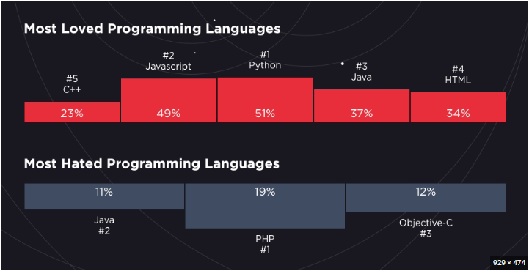
APPENDIX Popularity Popular Programming Languages
Hired's 2019 Survey of Software Engineers provided fresh insights into the landscape of programming languages, with a participation of 98,000 programmers.
The survey revealed unexpected results, with Java appearing on both lists for the most loved and most hated programming languages.
Interestingly, the reasons behind the dislike for Java stemmed from the lack of enjoyment in coding with it.
Conversely, Java's popularity among some respondents was attributed to the abundance of learning resources and supportive community atmosphere, facilitating software development and welcoming newcomers.
– PRESENTED DATA COMPARATIVELY

Slide 33
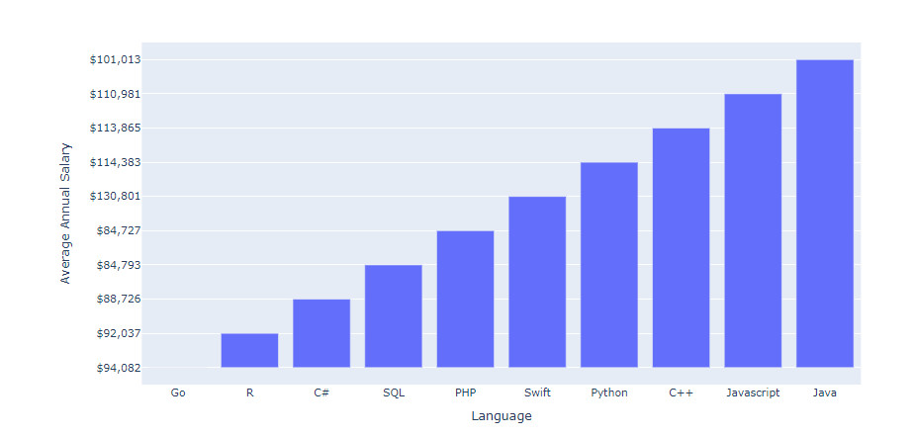
APPENDIX Salary Popular Programming Languages
– PRESENTED DATA COMPARATIVELY

Slide 34
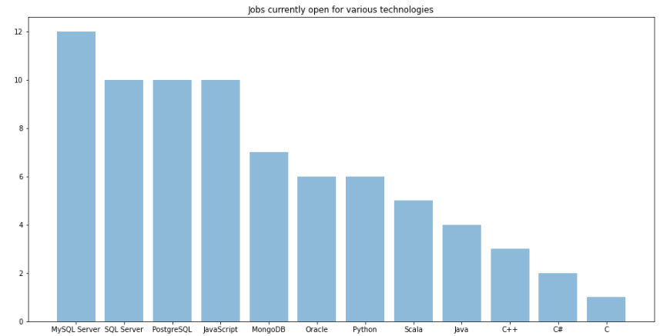
APPENDIX Jobs Popular Programming Languages
– PRESENTED DATA COMPARATIVELY

Slide 35
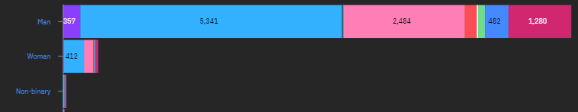

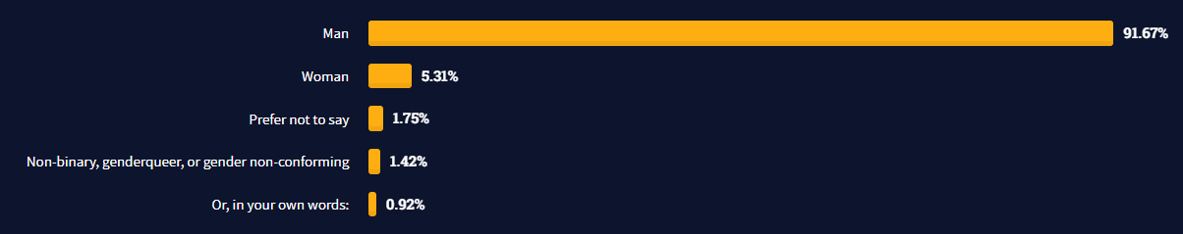
APPENDIX Demographic Gender
– PRESENTED DATA COMPARATIVELY

